Slide 1
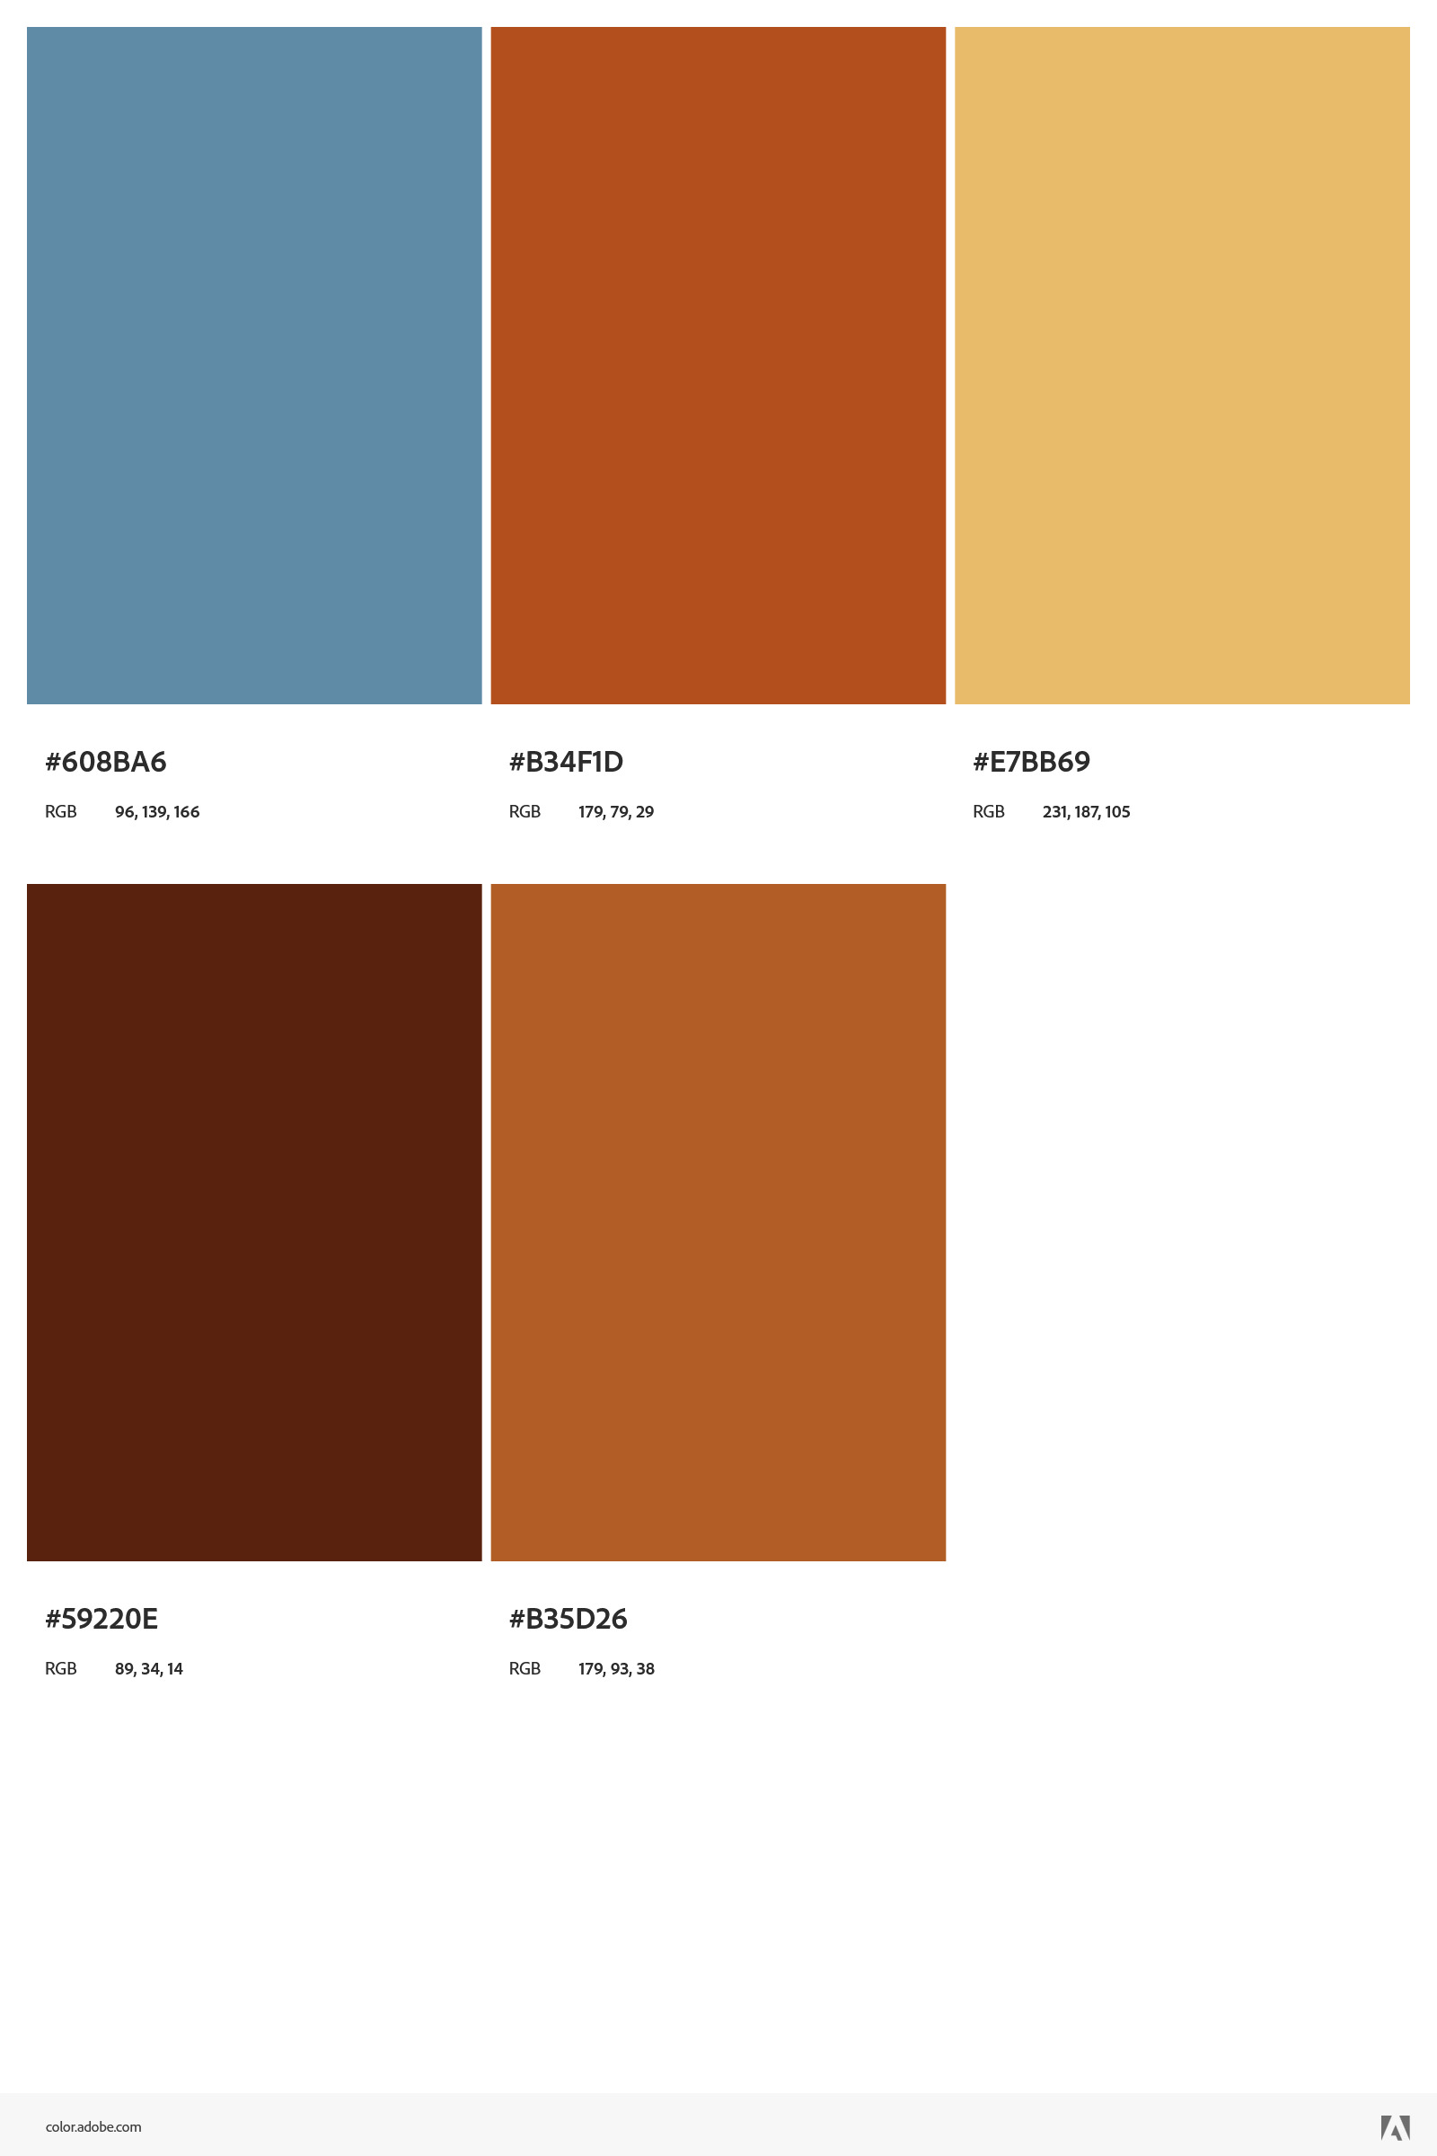


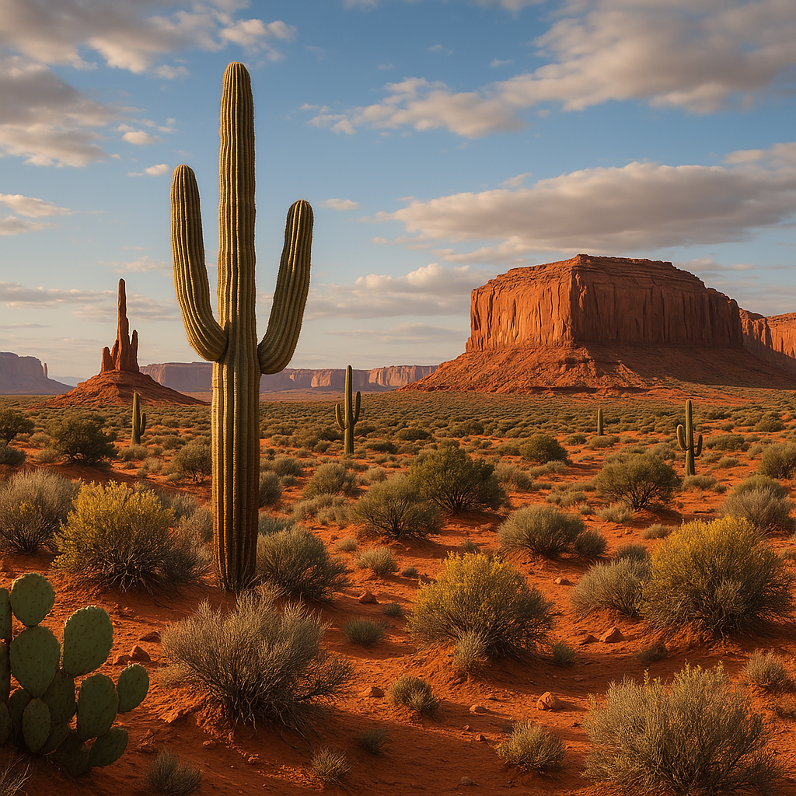
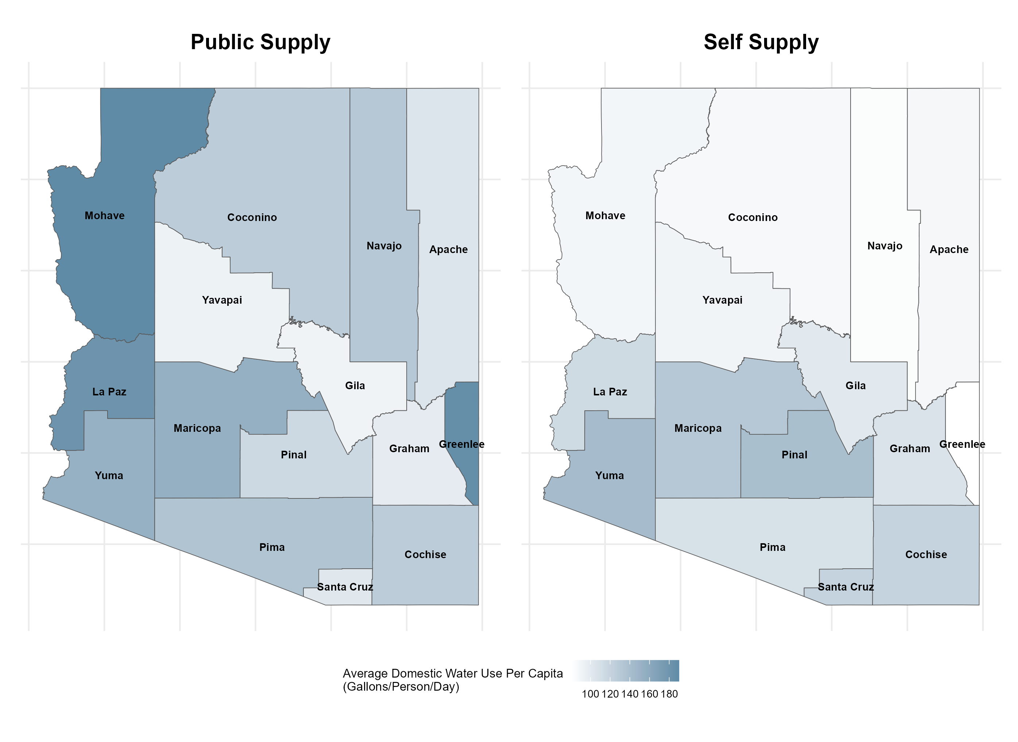
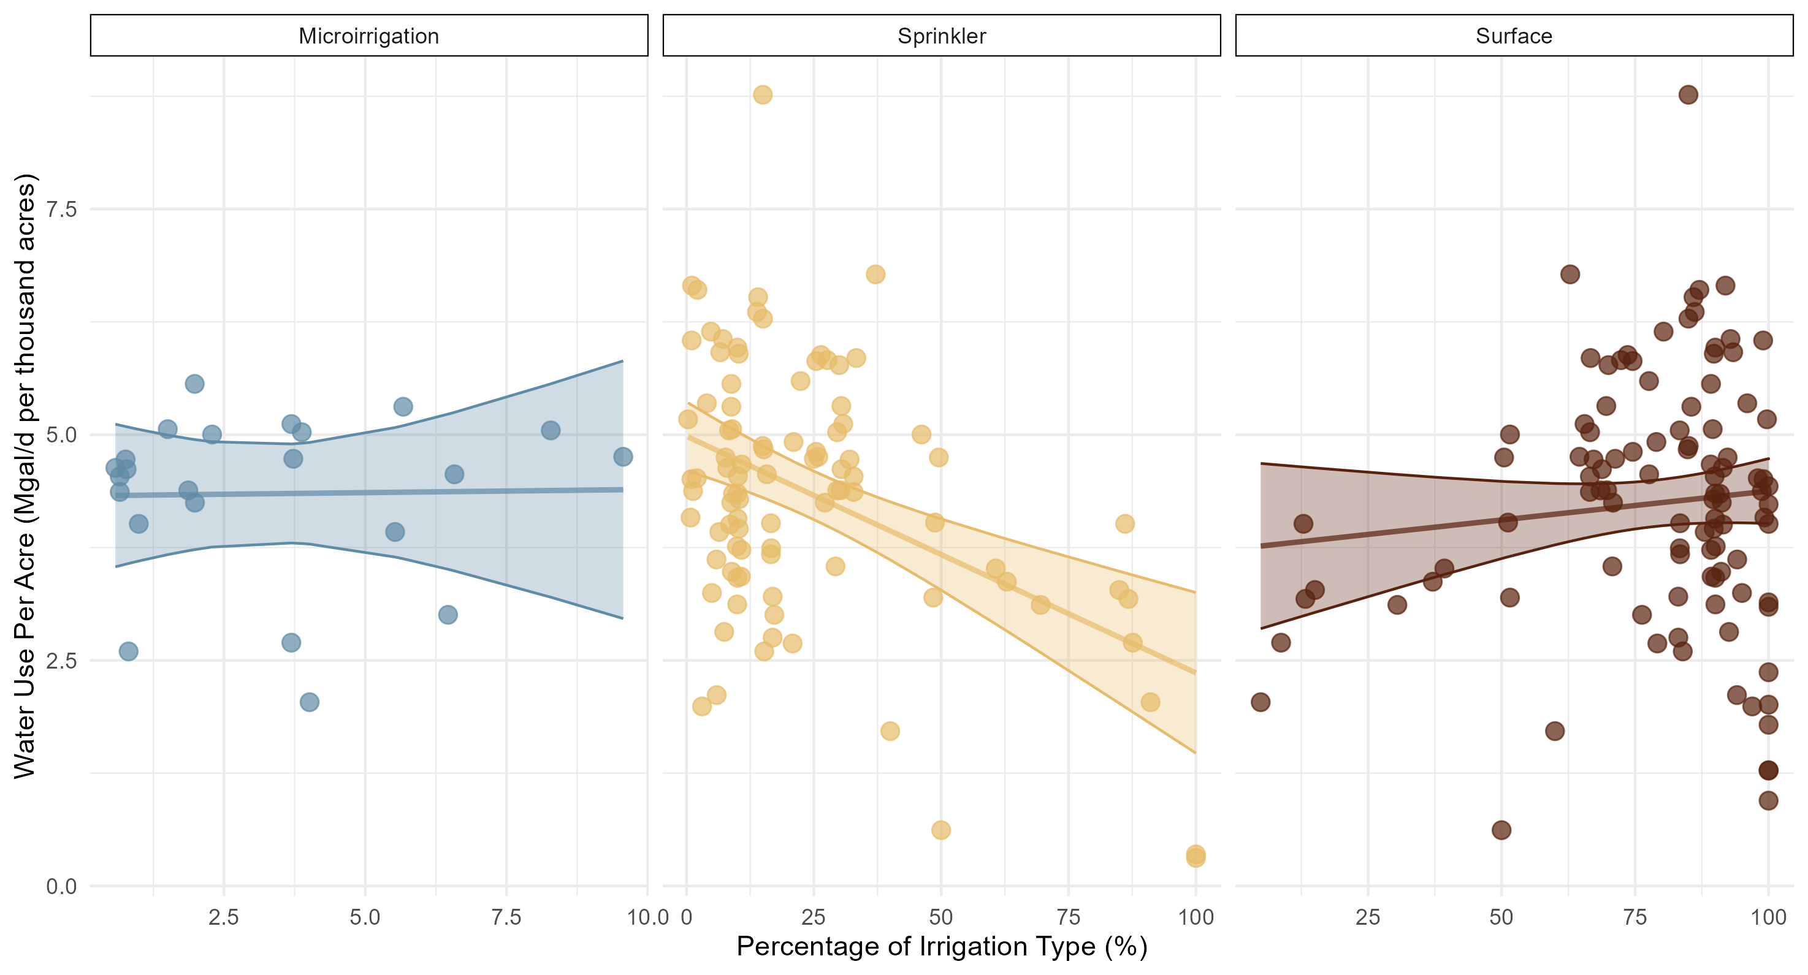
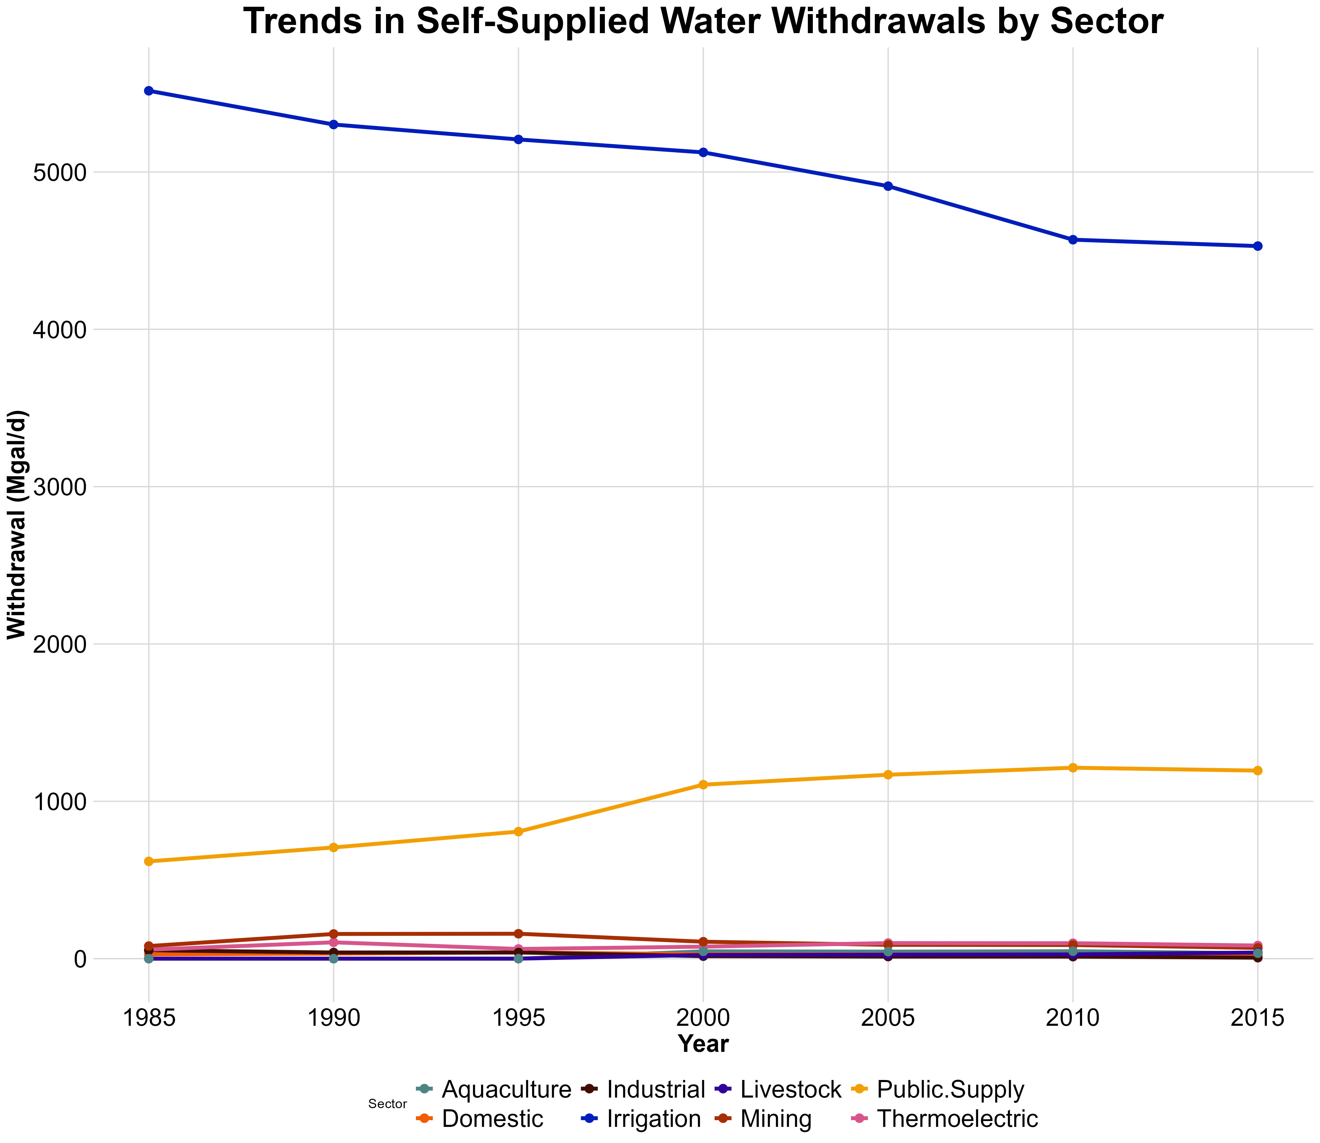
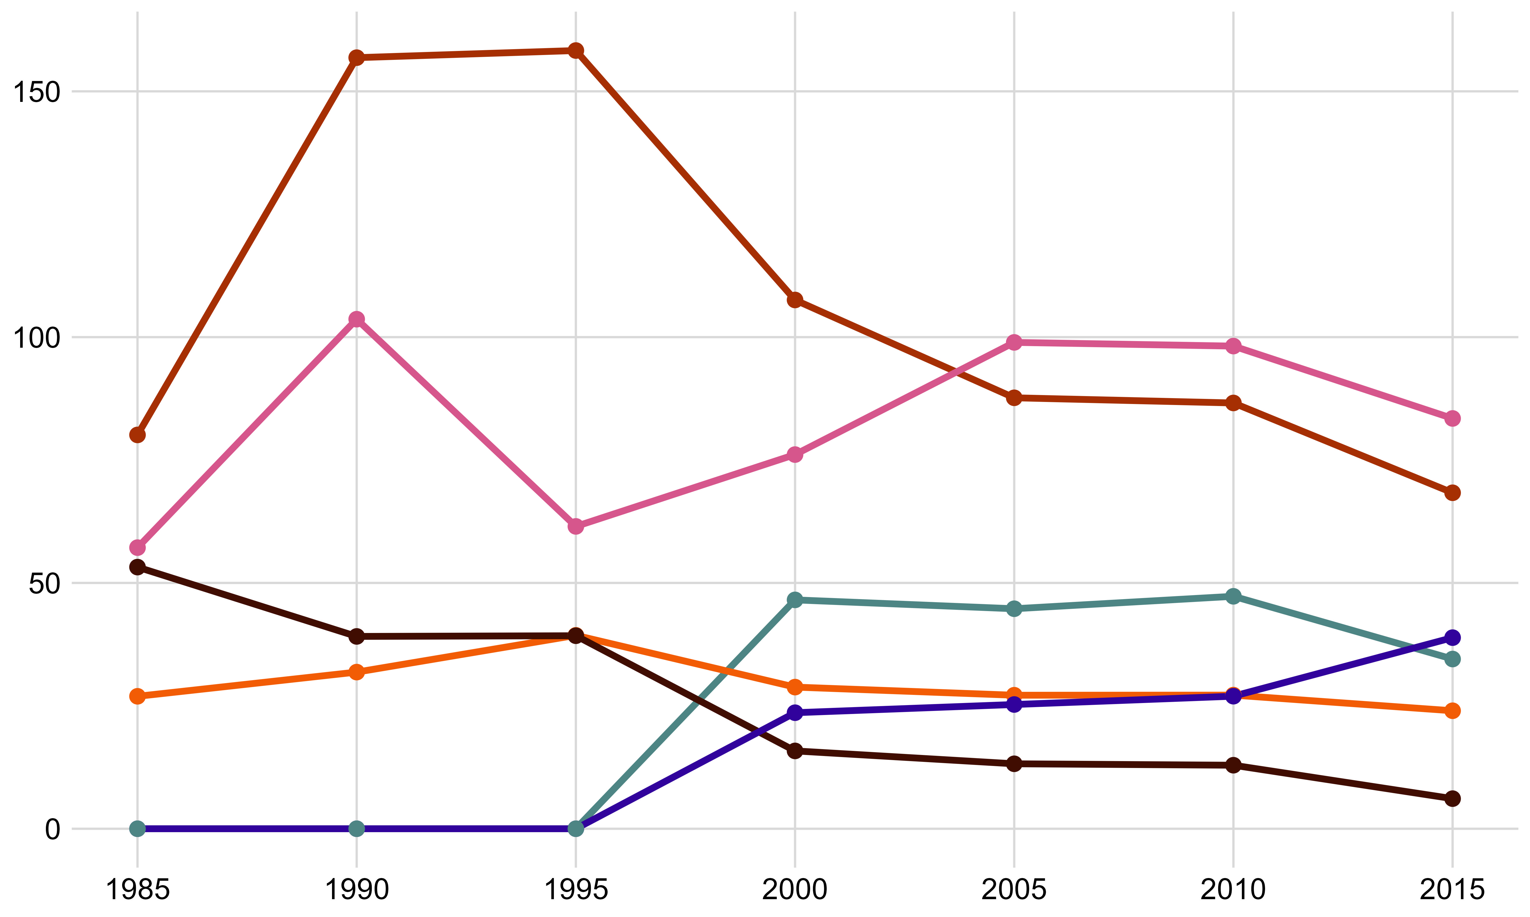


Arizona Water: A Framework for resource optimization
Jack Tomlon, Delila Medlin
The Department of Mathematics and Statistics, Northern Arizona University, Flagstaff, AZ 86011
Abstract
Analysis
Domestic sector includes all water used for indoor and outdoor household purposes. This includes drinking, cooking, bathing, laundry, dishwashing, flushing toilets, watering lawns and gardens, and maintaining pools.
A positive slope indicates low water use efficiency. A negative slope indicates high efficiency.
There is limited data on Micro-irrigation, so this relationship may not be properly reflected in this set.
As of March 2025, a staggering 99% of Arizona was in a state of drought (US Drought Monitor 2025).
Decreases in precipitation in our state have brought about concerns for the future of Arizona’s water future, and how the state is going to sustain our growing population and water consumption rates.
This project analyzes water production and consumption data from the United States Geological Survey (USGS) to identify anomalies and investigate sectors exhibiting unusual water loss in Arizona. The data, collected from publicly available USGS resources includes information on water withdrawals, usage by sector, and sources such as surface and groundwater. The goal is to uncover patterns and discrepancies that may indicate inefficiencies or areas for improved water management. Additionally, this analysis explores the potential ethical and environmental benefits of increasing the use of reclaimed water within Arizona’s water management strategy.
By identifying opportunities to optimize water use and integrate sustainable practices, the project aims to support more informed decision-making for managing Arizona’s limited water resources sustainably.
The plots to the right are the Domestic Water use per capita per person of water form the public supply and self-supplied to the sector
There is a large discrepancy between Domestic use from Public vs. Self-Supplied water.
Mohave and La Paz county seem to be dependent on publicly supplied water for domestic use
Pinal, Graham, Santa Cruz counties conversely use more self-supplied water over publicly-supplied
Modeling: Each Irrigation method was modeled by the interaction between Percentage of Irrigation Type and the Water Use Per Acre (M/gal per thousand acres). Outliers in the micro irrigation type with water use over 6 M/gal per thousand acres were excluded because the analysis of covariance provided significant evidence that the interaction was distinct between the three irrigation methods without them. Below is the output of this analysis.
Model 1: Water_Use_Per_Acre ~ Irrigation_Type + Percentage
Model 2: Water_Use_Per_Acre ~ Irrigation_Type * Percentage
 | Res.Df | RSS | Df | Sum of Sq | F | Pr(>F)
1 | 216 | 400.02
2 | 214 | 372.94 | 2 | 27.086 | 7.7712 | 0.000552
Arizona withdrawals are defined as water removed from a ground- or surface-water source for use.
The vast majority of water in the state is used for Irrigation, then through Public Supply withdrawals.
Irrigation and Public sector withdrawal the most water for Arizona.
The Public withdrawal also get sent to other sectors for use.
The blown-up figure shows sectors Domestic, Thermoelectric, Industrial, Mining, Livestock, and Aquaculture
The Problem
Discussion
Arizona is facing a critical water crisis due to a combination of prolonged drought, climate change, and overuse of water resources.
The Colorado River runoff has declined sharply, dropping reservoir levels in Lake Mead and Lake Powell to historic lows. (Schmidt et al., 2023)
The combined reservoirs storage lost 33.5 million acre-feet in the past 20 years, leaving only 15 months of average consumption reserves. (Schmidt et al., 2023)
Addressing these challenges requires substantial reductions in water use and the implementation of sustainable management practices to stabilize and recover water storage levels.
Arizona's water primarily goes to Industrial Agriculture Irrigation, with inefficient Surface Irrigation dominating, despite more efficient alternatives like Sprinkler and Micro-irrigation systems. While Agriculture remains vital to Arizona's economy, Irrigation efficiency can be improved. With Arizona being in the southwest desert our water management and public use it vitally important as our population increases. We found it statistically significant that there are differences in water efficiency between the irrigation methods. These differences need to be addressed and studied further to maintain efficient use in the Arizona agricultural sector. The community of Arizona needs to educate themselves and support proper legislation that help’s keep water in our homes and on our farms for future generations.
One way AZ is trying to improve this through 42 USC 10364: Water Management Improvement Bill. This bill authorizes the Secretary (presumably of the Interior Department) to provide grants to improve water management. Though there are some drawbacks with the bill.
Limited Tribal Considerations
Ceiling on how much funding can be received
Ambiguous language on which projects are prioritized
Looking into the Irrigation sector the USGS have 3 distinct methods or irrigating water.
Surface: using gravity and trenches to move water. Sprinkler: spraying water from above ground onto crop land. Micro-Irrigation: delivers water under low pressure, using emitters, drippers, or micro-sprinklers
The proportion of Surface watering has slowly decreased since 1985.
Conversely, the proportion of Sprinkler and Micro-irrigation watering has increased slightly.
Proportion of Irrigation method in Arizona
Year | Sprinkler | Micro-irrigation | Surface
1985 | 19.92% | 0.00% | 80.08%
1990 | 20.65% | 0.00% | 79.35%
1995 | 18.54% | 1.32% | 80.13%
2000 | 21.15% | 1.39% | 77.46%
2005 | 24.75% | 2.15% | 73.10%
2010 | 19.64% | 2.83% | 77.53%
2015 | 24.21% | 5.53% | 70.27%
Key Questions
What patterns or anomalies in water consumption can we identify across USGS sectors in Arizona?
Which sectors have a high potential for growth in efficient water use
How can we inform policy decisions aimed at optimizing water resources and mitigating the impacts of water scarcity
References & Acknowledgements
Dr. Robert Buscaglia,
Scan the QR codes for a link to the law in question and a properly formatted document of sources
USC 10364
Formatted Sources

